Slide 1
DELE CA1 Part B
By Davian

Slide 2
Overview Of The Workflow
Exploratory data analysis
Data Pre-processing
Creating the model
Conclusion
Model Improvement

Slide 3
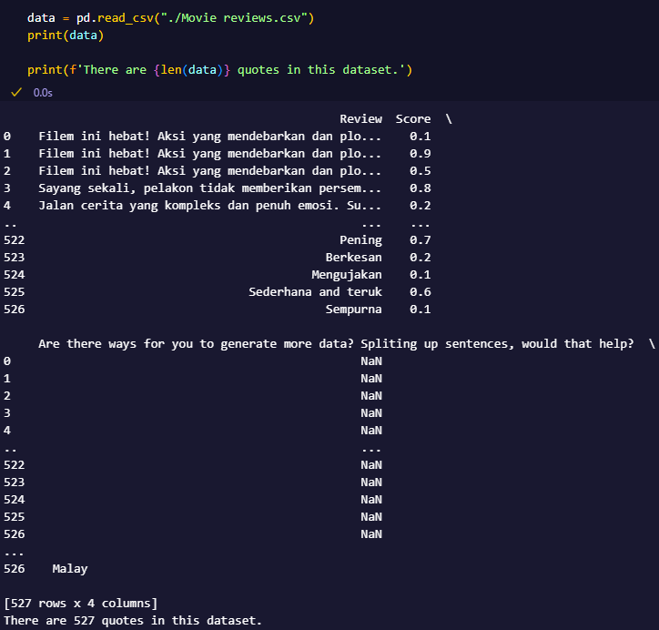
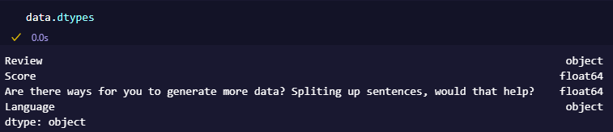
Importing Text Data
Use Pandas to import the text data into a dataframe

Slide 4
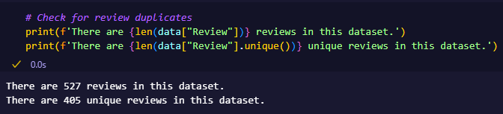

Data Pre-processing
We drop unnecessary columns followed by duplicates in the dataset.

Slide 5
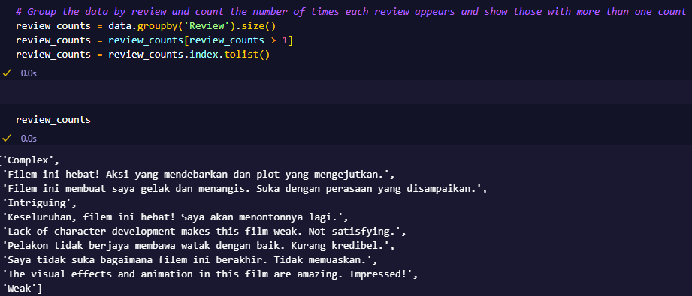
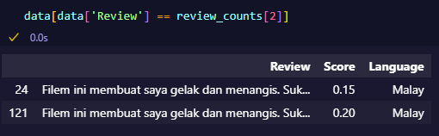

Data Pre-processing
After that, I group the data by review and count the number of times each review appears and show those with more than one count.
I then manually go through each of the remaining duplicate reviews to manually deal with each one of them.
Not removing 'Complex' as it has a score of 0.65 and 0.10 as 'Complex' can have a negative and positive connotation to it
- 'Filem ini hebat! Aksi yang mendebarkan dan plo...' is actually positive when using Google Translate so I will remove the duplicates with negative score
- "Keseluruhan, filem ini hebat! Saya akan menontonnya lagi." is positive so I will remove the negatively score one

Slide 6
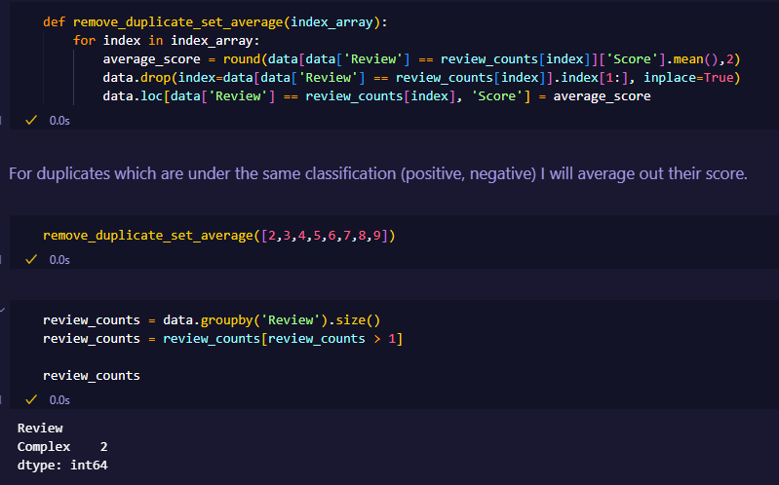
Data Pre-processing
For the rest of the remaining duplicated reviews, they are all under the same classification and thus I will average out their score before removing the duplicates.
In the end, we are left with only Complex as the remaining duplicate.

Slide 7
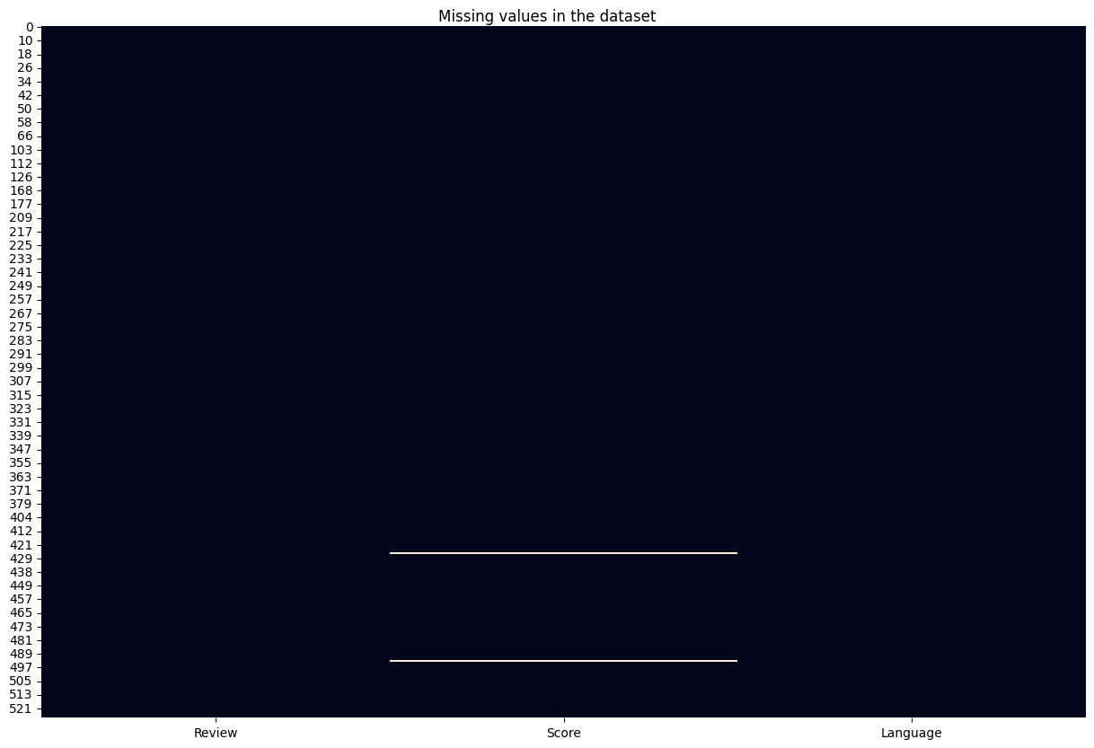
Data Pre-processing
As there are 2 null rows, which is a small amount, I can remove them without it having a huge impact on the dataset size.

Slide 8
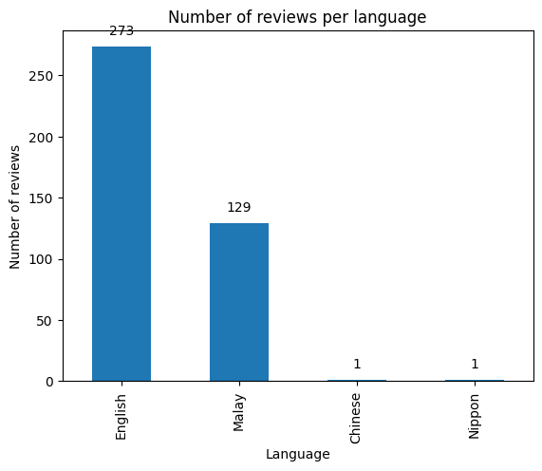
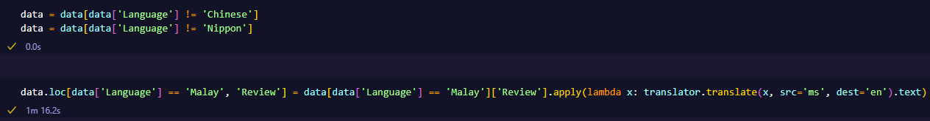
Data Pre-processing
As Chinese and Nippon only has only 1 data in it each, it would only make sense to remove it entirely. As the English dataset has only 273 sets of data in it which isn’t a lot, I will convert the Malay dataset into English so that we will have a larger dataset to work with.

Slide 9
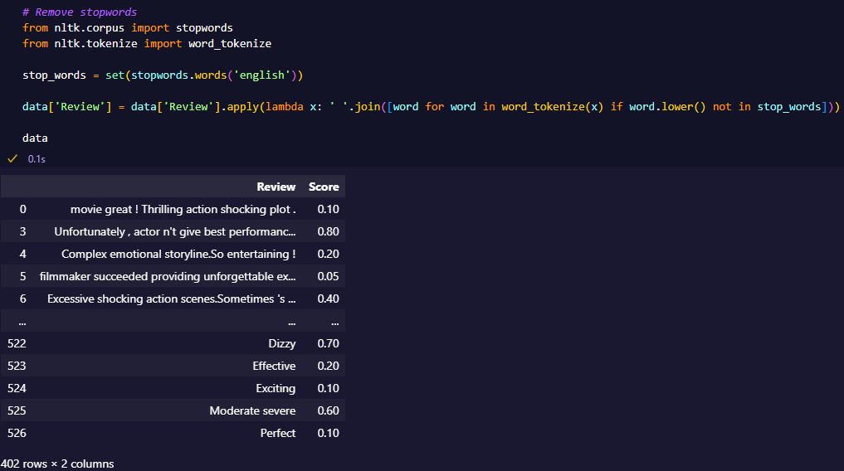
Data Pre-processing
Next, we remove stopwords which are words that do not carry significant meaning and can be ignored.

Slide 10
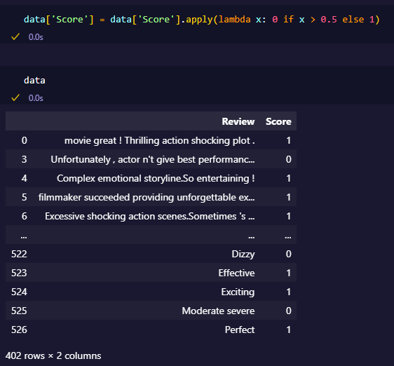
Data Pre-processing
We will do classification for this dataset as the dataset is quite small and it will be easier for the model to predict discrete classes rather than a continuous range. If score is >0.5 then review is negative else positive. Replace Score with 0 for negative and 1 for positive.

Slide 11
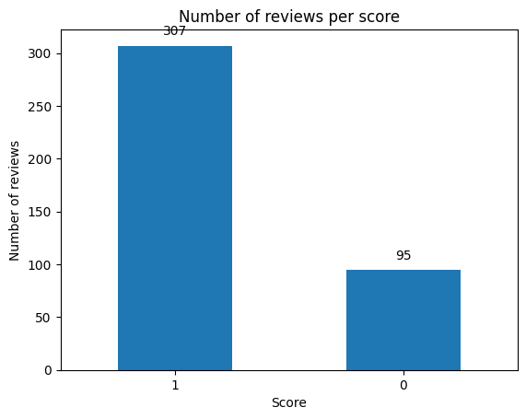
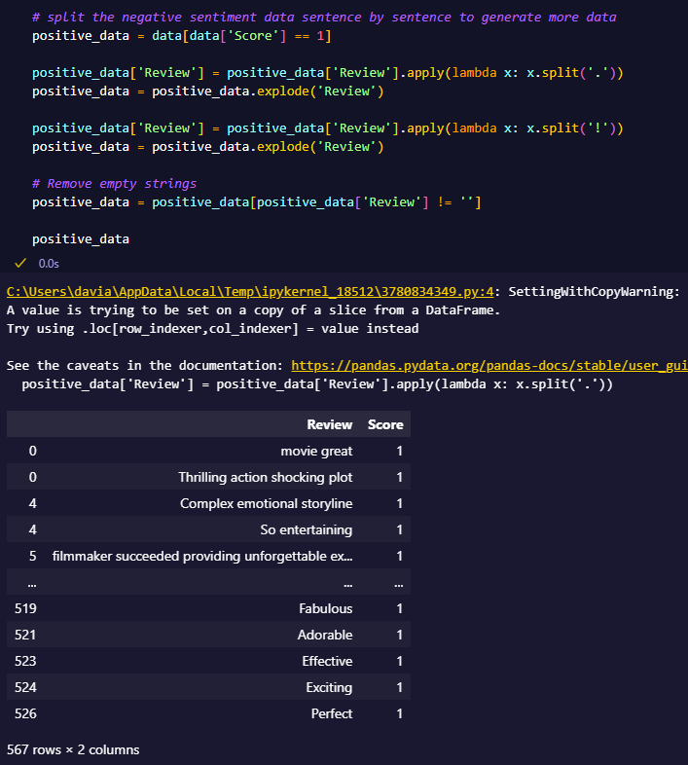
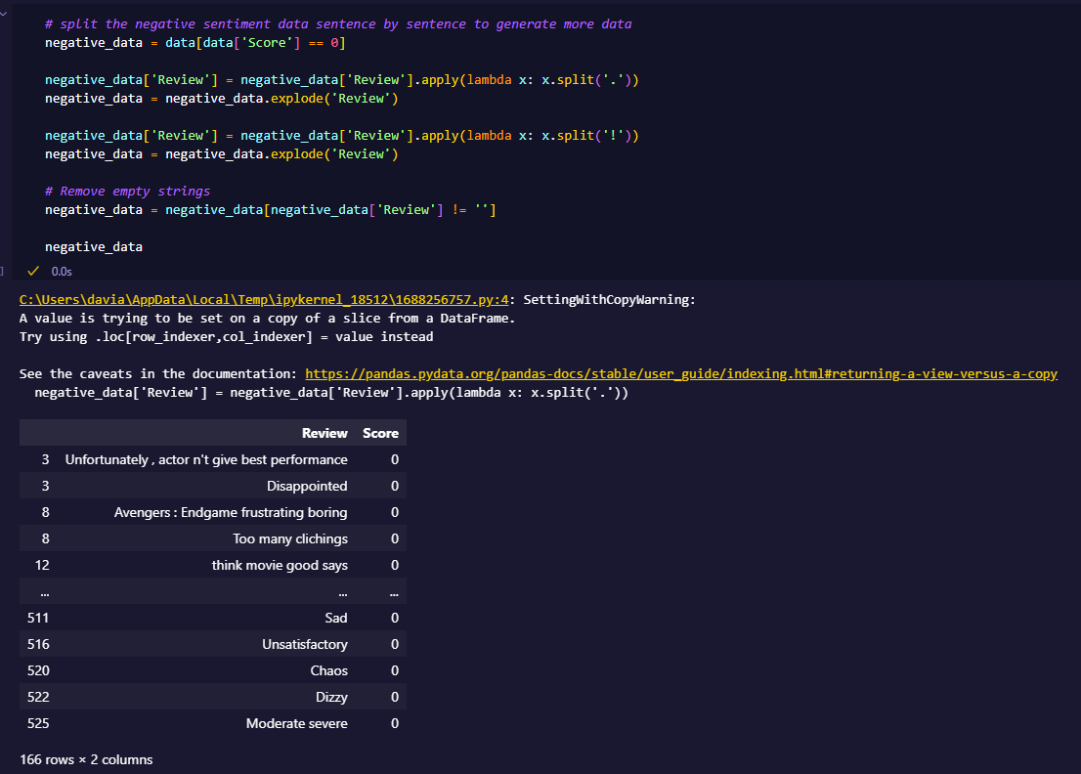
Data Pre-processing
There are still not a lot of data to work with. To help increase the dataset size, we will split up sentences in the reviews.

Slide 12
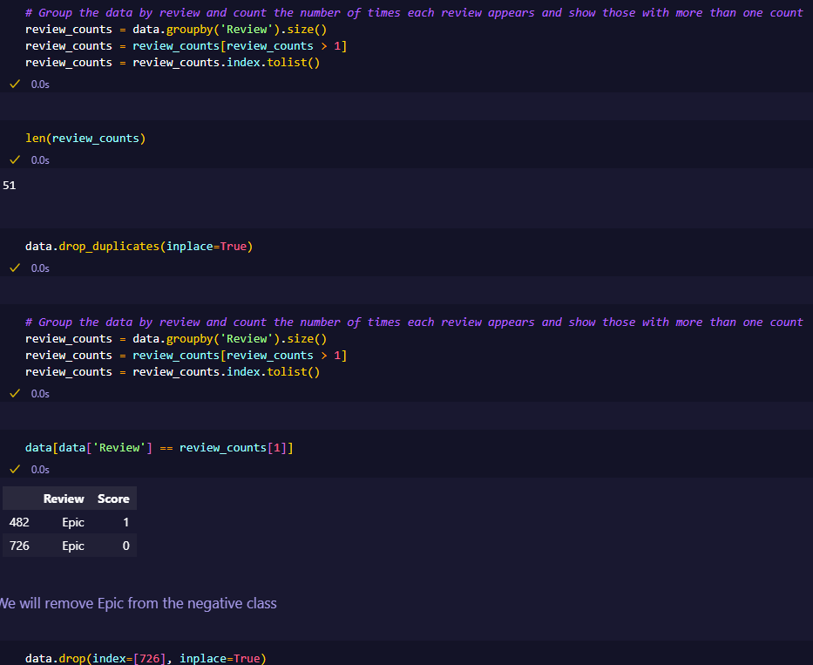
Data Pre-processing
After all the preprocessing, we check for duplicates one last time only to find out we have 51 duplicated reviews from splitting up the sentences.
We will remove the duplicates.
The remaining duplicate is ‘Epic’ which we will remove the negative one.

Slide 13
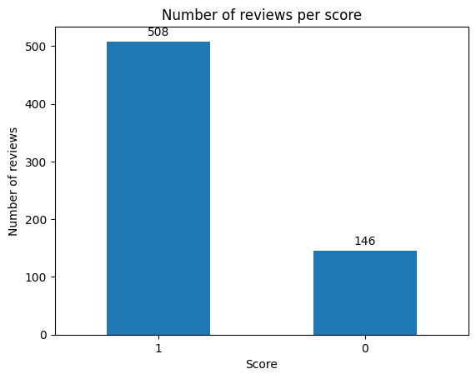
Exploratory Data Analysis
There is a class imbalance. There is significantly more positive than negative reviews. We will have to account for this later when fitting the model.

Slide 14
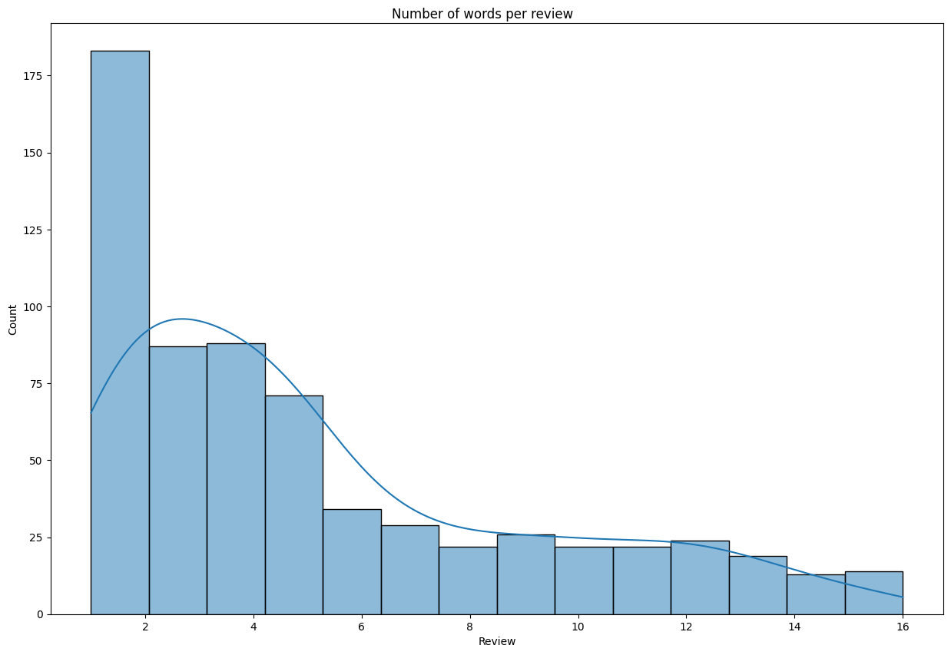
Exploratory Data Analysis
From the graph, most of the reviews seems to be 1 word long. The distribution is positively skewed.

Slide 15
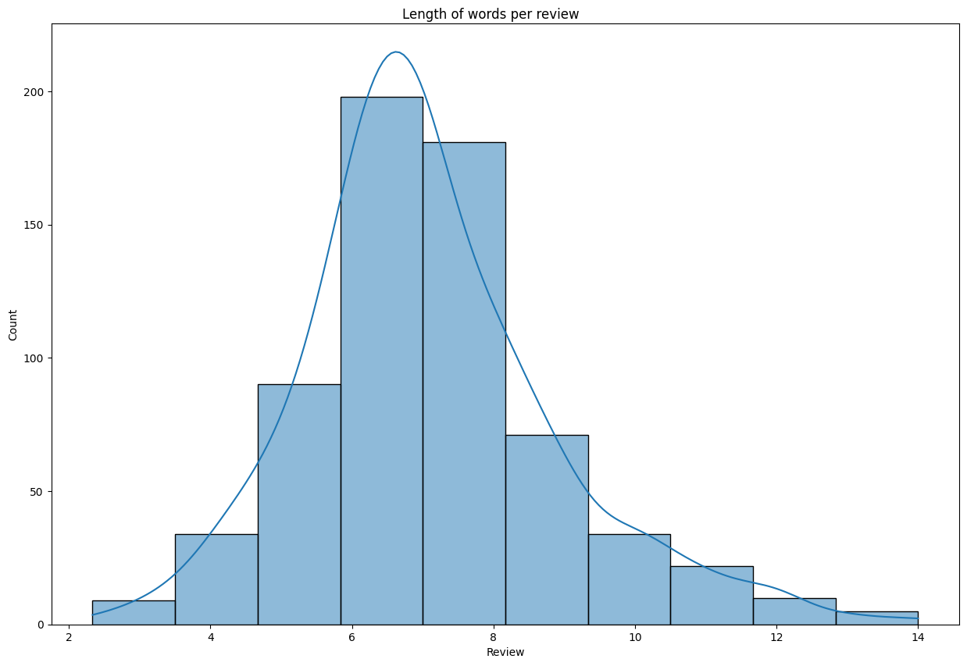
Exploratory Data Analysis
From the graph we can see that the average word length ranges between 2 to 14 with 6 being the most common.

Slide 16
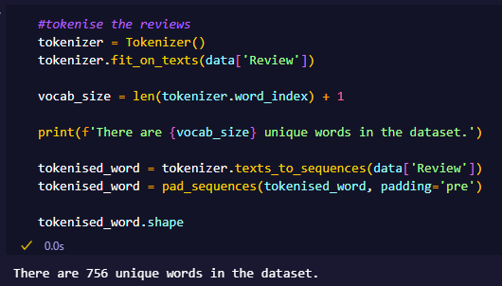
Tokenization
I tokenized the sentences and did pre-padding on it to make it all the same size.
There are 756 unique words.

Slide 17
Train-Test-Validation Split
As this dataset is small, we will do a 70-15-15 train test validation split.

Slide 18
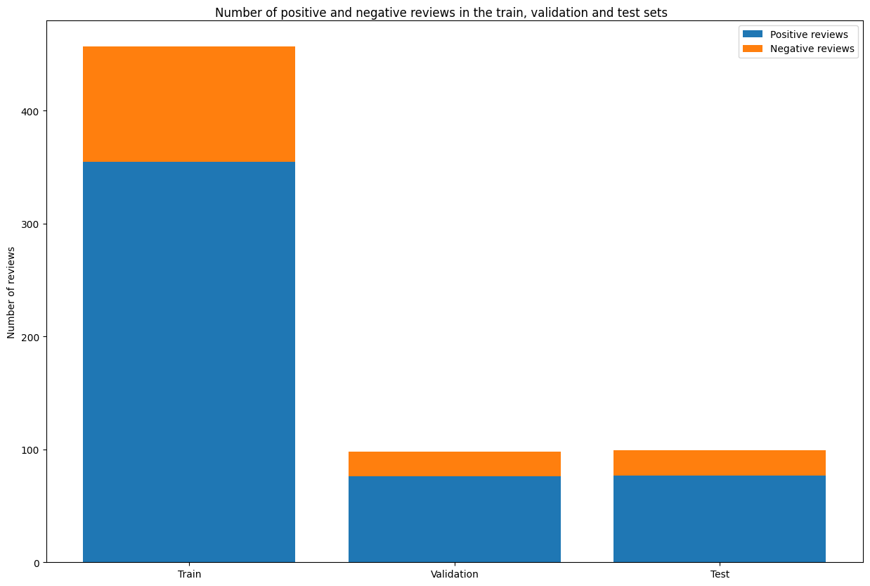
Train-Test-Validation Split
Train set has 102 negative reviews and 355 positive reviews.
Validation set has 22 negative reviews and 76 positive reviews.
Test set has 22 negative reviews and 77 positive reviews.

Slide 19
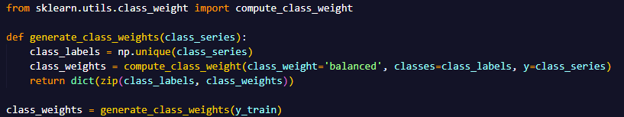
Calculating Class Weights
To help counter the class imbalance, we will use class weights when fitting the models.

Slide 20
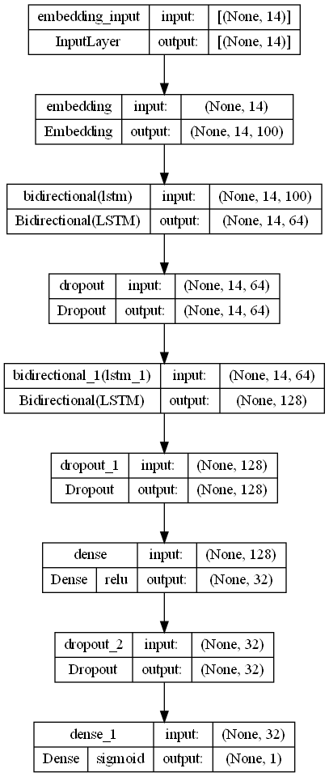
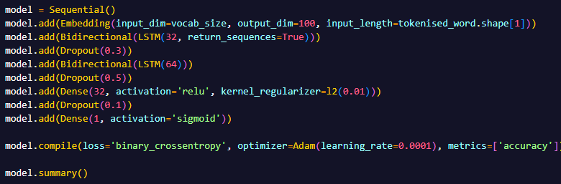
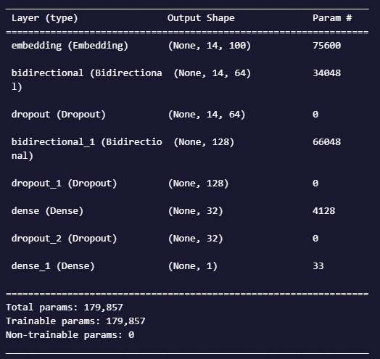
Model
To improve the model, I added dropout to prevent overfitting, played around with the amount and type of layers and the number of neurons
The learning rate of Adam was set to 0.0001 to help reduce volatility in the loss and accuracy scores.
This model has a total of 179,857 trainable parameters

Slide 21
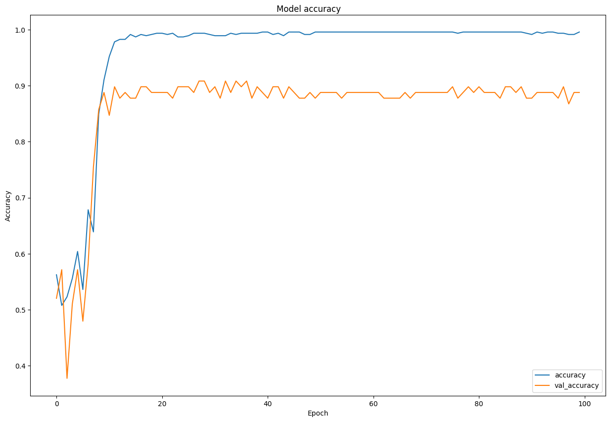
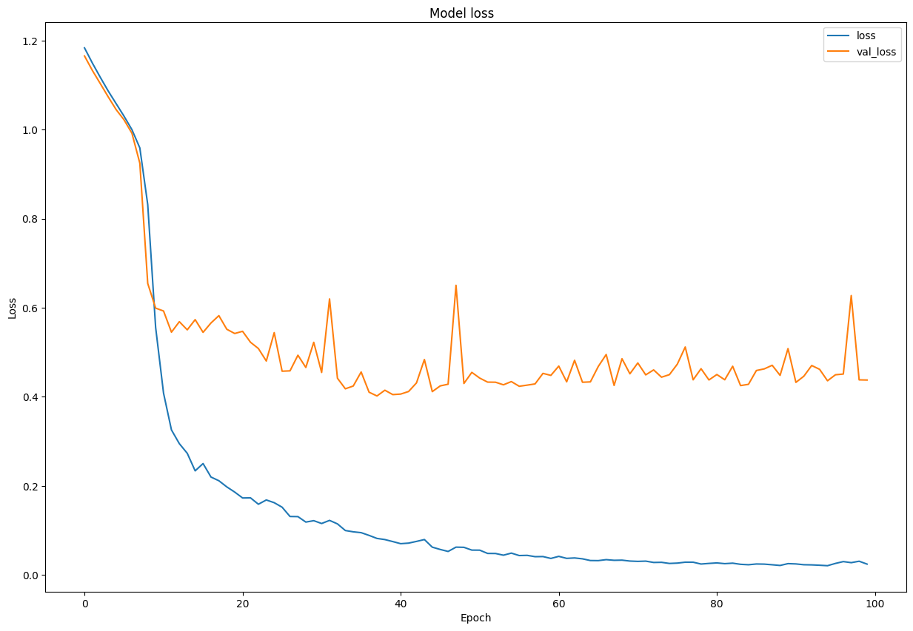
Model
From the model loss graph, there is no overfitting of the model onto the training data.

Slide 22
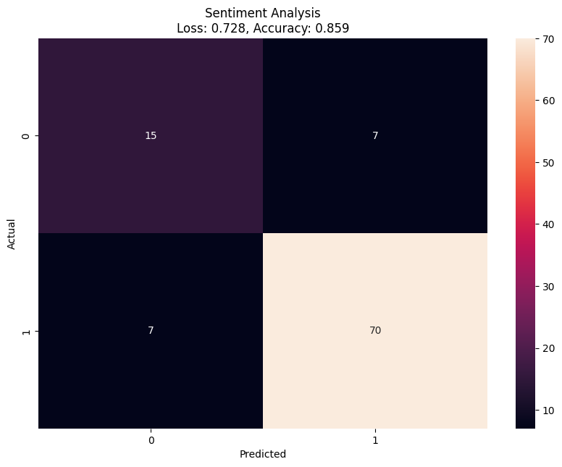
Model
The Model has a loss of 0.702 and an accuracy of 85.9% when tested on the testing data.
From the confusion matrix, you can see that the model classifies most of the images correctly. The number of images classified wrongly is the same for both positive and negative.

